Slide 1
Bandit –
A Wargame For Linux Beginners
Lab-2

Slide 2
LEVEL 5 TO 6
Level Goal
The password for the next level is stored in a file somewhere under the inhere directory and has all of the following properties:
human-readable
1033 bytes in size
not executable
Commands you may need to solve this level
ls , cd , cat , file , du , find

Slide 3
Bandit – A Wargame For Linux Beginners
The password for the next level is contained within a file that meets specific criteria: it’s 1033 bytes in size, it’s meant for human readability rather than program execution, and it’s located within the “inhere” directory. This directory contains 19 more directories, each of which contains files with identical names.
Solution
An alternative approach is available, where the “find” command is employed to locate the required password file. The command “find . -type f -size 1033c” is utilized, and it essentially instructs the computer to search within the “inhere” directory and its subdirectories for files that match the criteria of being exactly 1033 bytes in size and not being directories.
find . -type f -size 1033c

Slide 4
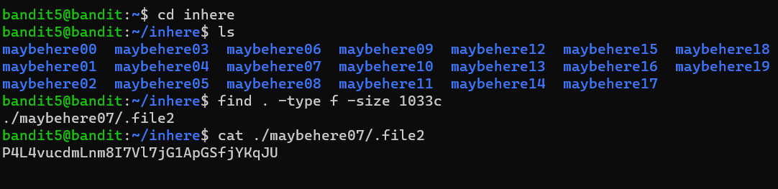
To start I "cd" into the inhere folder and ran "ls" to see the files and folders and noticed that there were a bunch of folder and inside those folders a couple of files.
To make my life easier and not have to read every file I tried to "find" a way to look for the specific file with the properties given. I looked through the manual page of the find command and looked for ways of pointing out the properties of the file. I found the -size, -type, and -executable options.

Slide 5
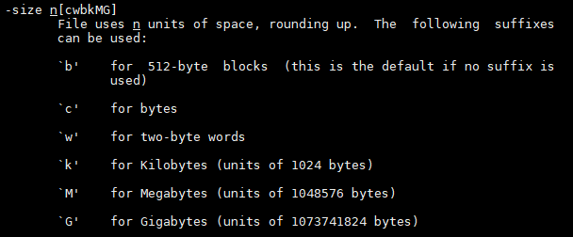
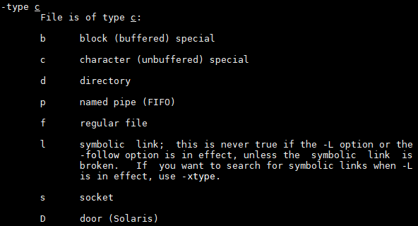
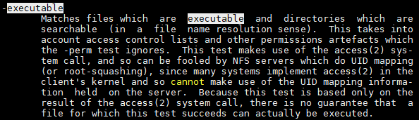

Slide 6
I put them together with the properties given and I ran the "find" command below:
find -type f -size 1033c ! -executable
It looks for a file that is size 1033 bytes and it is not executable. The output was ./maybehere07/.file2 and then I read the file I see that the password is
Username : bandit6
Password: P4L4vucdmLnm8I7Vl7jG1ApGSfjYKqJU

Slide 7
LEVEL 6 TO 7
Level Goal
The password for the next level is stored somewhere on the server and has all of the following properties:
owned by user bandit7
owned by group bandit6
33 bytes in size
Commands you may need to solve this level
ls , cd , cat , file , du , find , grep
To locate a file meeting the specified criteria (owned by user “bandit7,” owned by group “bandit6,” and 33 bytes in size), the following “find” command was employed:

Slide 8
For this part I used the find command below to find a file owned by user bandit7, owned by group bandit6 and 33 bytes of size.
find / -user bandit7 -group bandit6 -size 33c 2>/dev/null
Explain:
/ from root folder
-user the owner of the file.
-group the group owner of the file.
-size the size of the file.
2>/dev/null redirects error messages to null so that they do not show on stdout.
With that command we found the file in the following directory: /var/lib/dpkg/info/bandit7.password. When I read the file, I found that the password is
Username: bandit7
Password : z7WtoNQU2XfjmMtWA8u5rN4vzqu4v99S

Slide 9
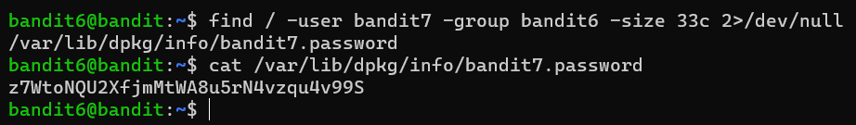
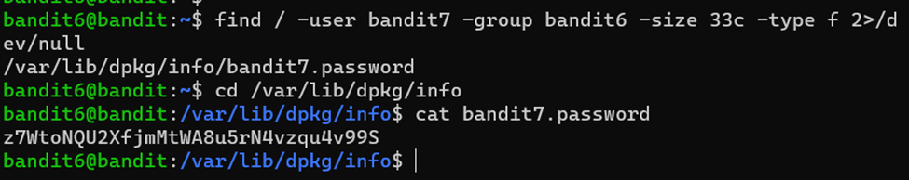
OR

Slide 10
Bandit Level 7 → Level 8
The password for the next level is stored in the file data.txt next to the word millionth
Commands you may need to solve this level
man, grep, sort, uniq, strings, base64, tr, tar, gzip, bzip2, xxd
The password for the next level is located in the “data.txt” file next to the word “millionth.” Although attempting to manually read the contents of this file is impractical due to its size, an alternative command called “grep” is employed to identify and print all the lines within the “data.txt” file that include the word “millionth.” Consequently, the password for bandit8 is now obtained.

Slide 11
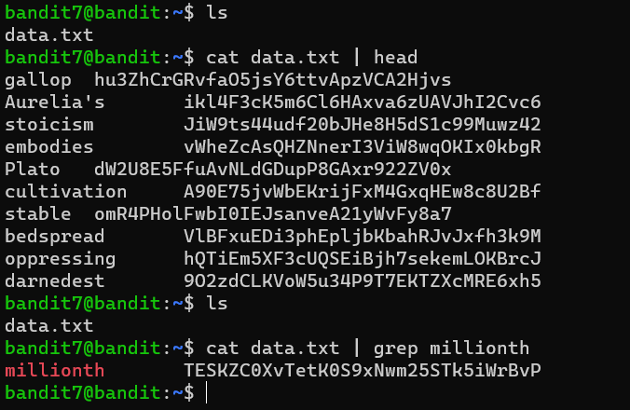
When I logged into the profile I saw the data.txt file and when I read it a bunch of lines came up and it looked like all of the lines had the same structure. It was a word followed by some spaces and then a possible password. The hint was that the password is next to the word millionth, so I used the command below to read the file and then grep the word millionth.
cat data.txt | grep millionth
The command only return 1 line and it contained the password:
Username: bandit8
Password : TESKZC0XvTetK0S9xNwm25STk5iWrBvP

Slide 12
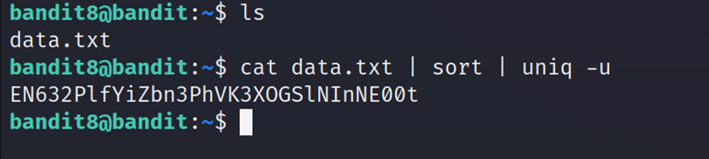
Bandit Level 8 → Level 9
Level Goal
The password for the next level is stored in the file data.txt and is the only line of text that occurs only once
This command sorts the content of data.txt and then displays the lines that occur only once
To do this I ran the command below in order to sort the lines alphabetically and then remove all duplicates from the output.
sort data.txt | uniq -u
Username: bnadit9
Password: EN632PlfYiZbn3PhVK3XOGSlNInNE00t

Slide 13
Remove duplicate lines with uniq
After sorting a file you will often find that some duplicate data, or you may be given various lists that need deduping. sort and uniq will quickly and easily remove duplicates, list only the dupilcates or only the unique data.
sort myfile.txt | uniq
List only the unique lines: sort myfile.txt | uniq -u
List only the duplicate lines: sort myfile.txt | uniq -d
Get a count of the number of lines by adding the -c option.
sort myfile.txt | uniq -uc
sort myfile.txt | uniq -dc
Skip fields: uniq -f 3 mylogfile. this could be useful with log files to skip the time stamp data
Skip characters. uniq -s 30 myfile.txt. Skip the first 30 characters
Compare characters. uniq -w 30 myfile.txt. Compare the first 30 characters
Reference:
http://www.liamdelahunty.com/tips/linux_remove_duplicate_lines_with_uniq.php

Slide 14
Bandit Level 9 → Level 10
Level Goal
The password for the next level is stored in the file data.txt in one of the few human-readable strings, beginning with several “=“ characters.
As per the hint, it was noted that the file contained a mixture of strings and binary data, potentially causing readability challenges. To segregate the plain text, the “cat data.txt | strings” command was executed. Subsequently, the lines commencing with the “=” sign were sought after using the command:
To do this I ran the command below
cat data.txt | strings | grep "=="

Slide 15
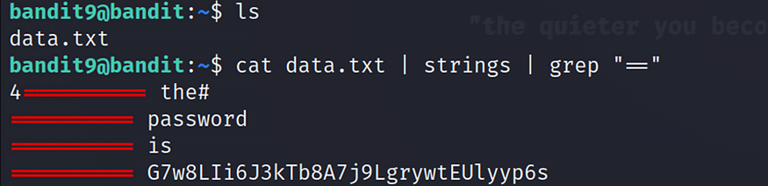
Several “=” signs are initiated at the beginning of each of them, and if the same format for all passwords is followed, it is anticipated that the password will be located as the last line.
Username: bnadit10
Password: G7w8LIi6J3kTb8A7j9LgrywtEUlyyp6s

Slide 16
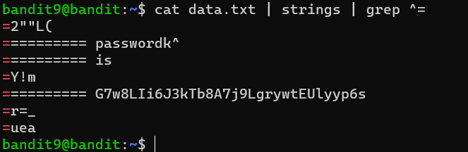
other solution
According to the hint, the file contains both strings and binary data which can make it difficult to read. In order to sort out the plain text I ran "cat data.txt | string". The next part is to grep the lines that start with the = sign. To do everything in 1 line I used the command below:
cat data.txt | strings | grep ^=

Slide 17
THANK YOU

